Slide 1

Stevens Milee
- Shivani Taneja, Rucha Bhatawadekar, Jaitul Bharodiya

Slide 2
01
Project Description

Slide 3
Project Description
Stevens Milee is a networking website where a student:
Can find information about the courses which he/she desires to enroll in for a particular semester
Can find information about the Professor teaching a course
Can check rating given by other students to the course and the Professor
Can check reviews given by other students to the course and the Professor
Can rate the course on the basis of difficulty of assignments, lecture material, quizzes, find whether the course has project work or exam
Can rate the Professor
Can also give comments about the course

Slide 4
02
Manifesto

Slide 5
Manifesto
When we, as current Stevens students, try to register for a course for a particular semester, we often have many questions in mind about the course. Like who is the faculty, whether the course is on-campus or web-campus, how difficult a course is, what is the level of learning, what are the skills that a student will acquire if he/she enrolls for a particular course, is the course aligned with industry, does the course involves any project or does it has final exam at end of the semester, how often will the quizzes be conducted? Will it be weekly or bi-weekly, does that course has any hands-on lab experience?
So, because of all these questions, a student has to ask his peers who have taken the course earlier or have to ask senior students about the course, which becomes time-consuming and not everyone has contacts with students who have enrolled for a particular course before.
To make the process easy, we came up with the idea of developing a platform where all the student queries will be solved. By using Stevens Milee, a student can get answers to all the questions mentioned above which makes it easy and a smooth experience for him/her to enroll for a course.

Slide 6
03
Development Plan

Slide 7
Roles and Responsibilities
Development Lead:
Buildmeister:
Shivani Taneja
Jaitul Bharodiya
Architect:
Developers:
Rucha Bhatawadekar
Shivani Taneja, Jaitul Bharodiya, Rucha
Bhatawadekar
Test Lead:
Testers:
Shivani Taneja
Shivani Taneja, Jaitul Bharodiya, Rucha
Bhatawadekar

Slide 8
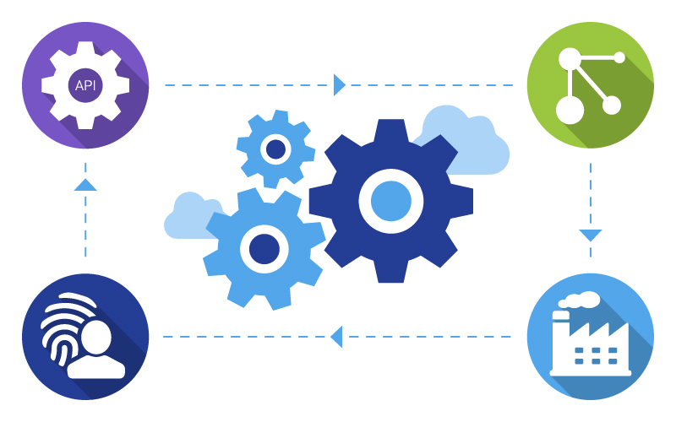
Development Environment
Process:
Agile (Scrum)
Tools & Libraries:
Frontend framework: AngularJS (Version 1.5.8)
Backend framework: Spring 5
Testing framework: Selenium
Operating System: MacOS Catalina, Windows 10
Database: AWS RDS
APIs are hosted on Amazon EC2
Swagger is used for API Documentation

Slide 9
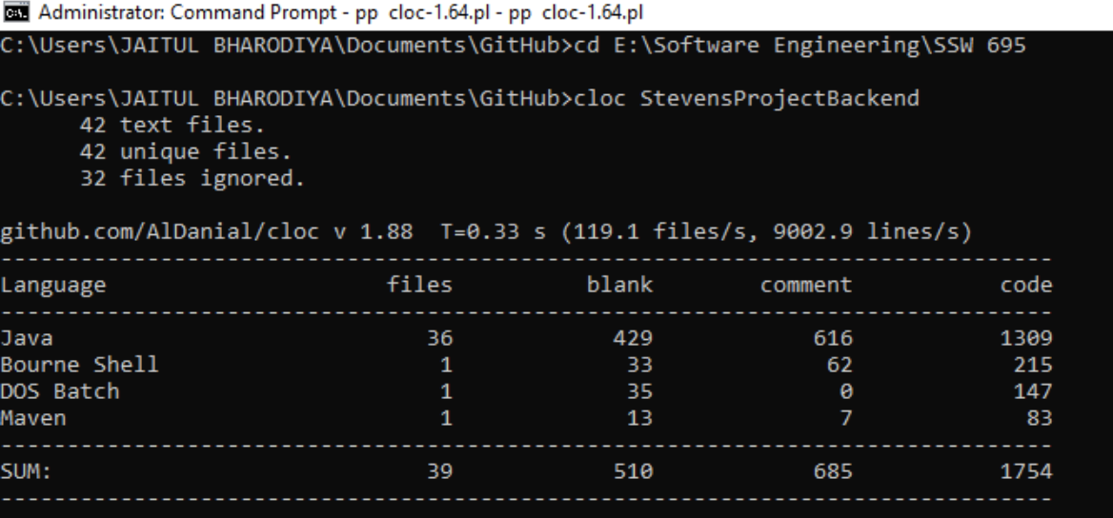
Metrics
Total LOC (Backend)

Slide 10
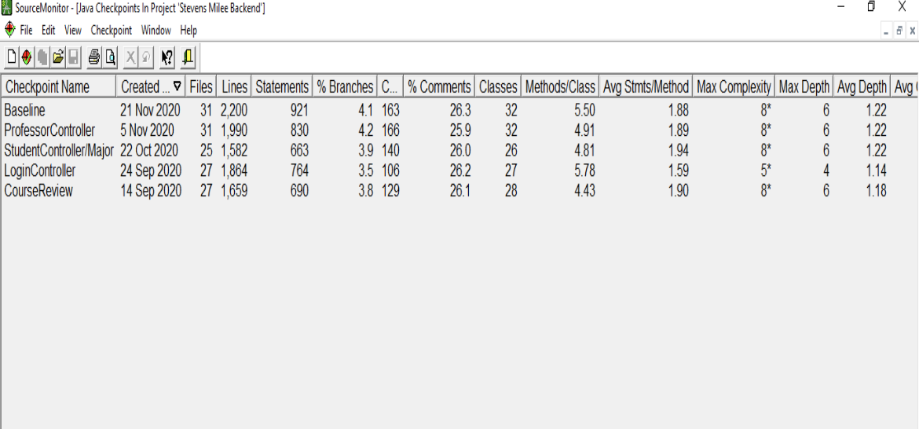
Backend Metric

Slide 11
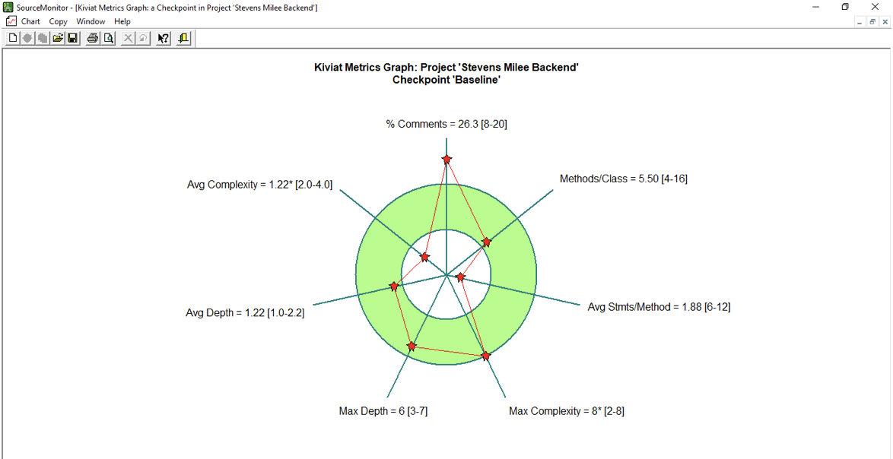
Kiviat Metric Graph

Slide 12
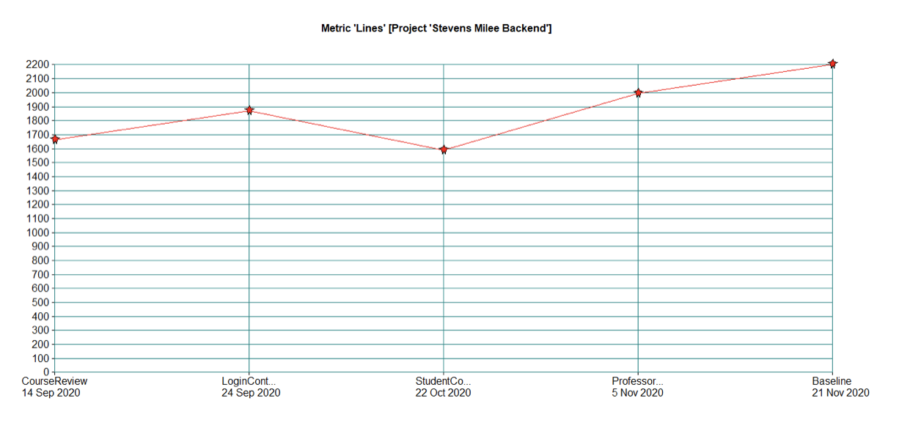
LOC Graphical View

Slide 13
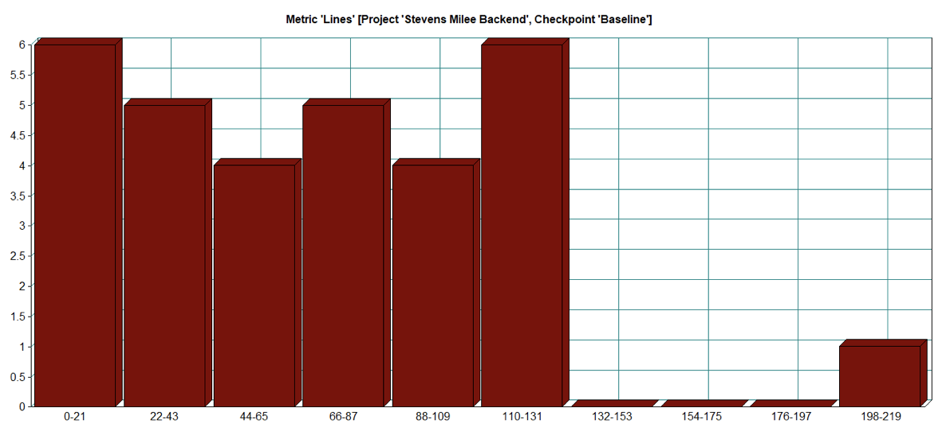
Avg. Lines/Mod

Slide 14
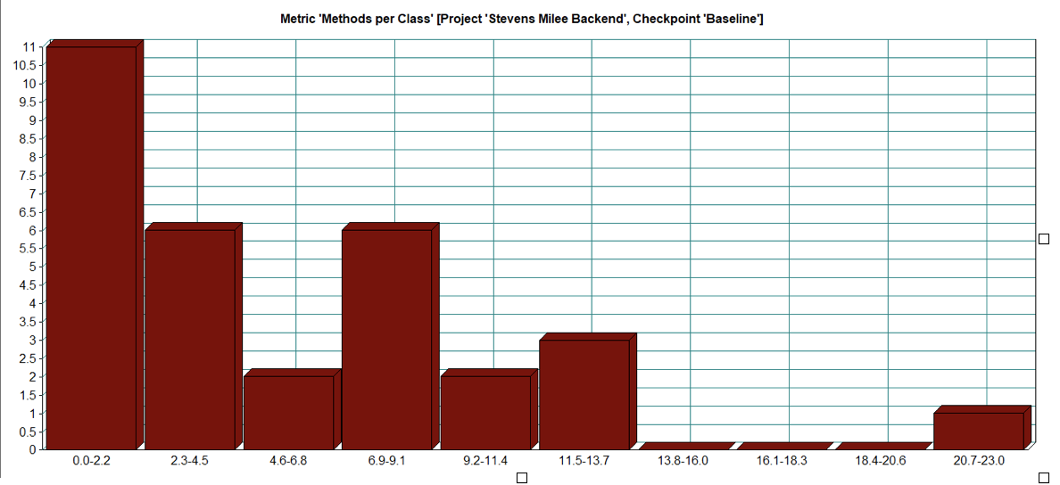
Method/Class

Slide 15
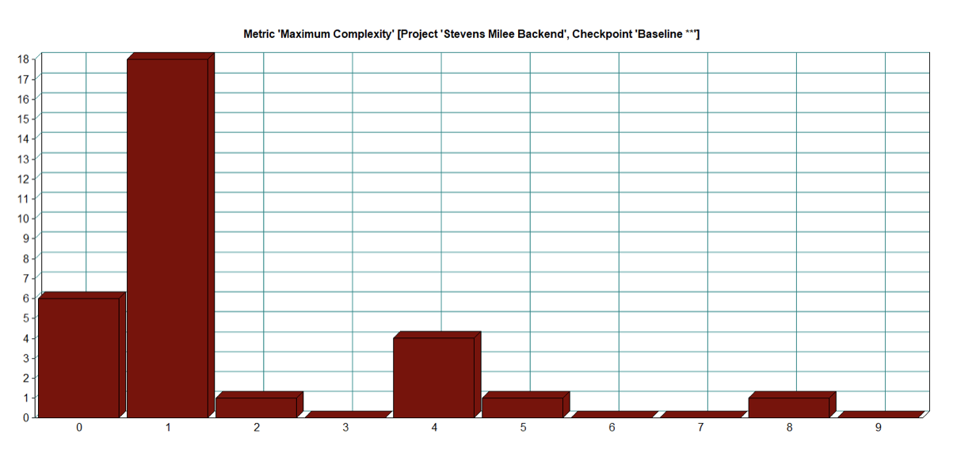
Max Complexity/Method

Slide 16
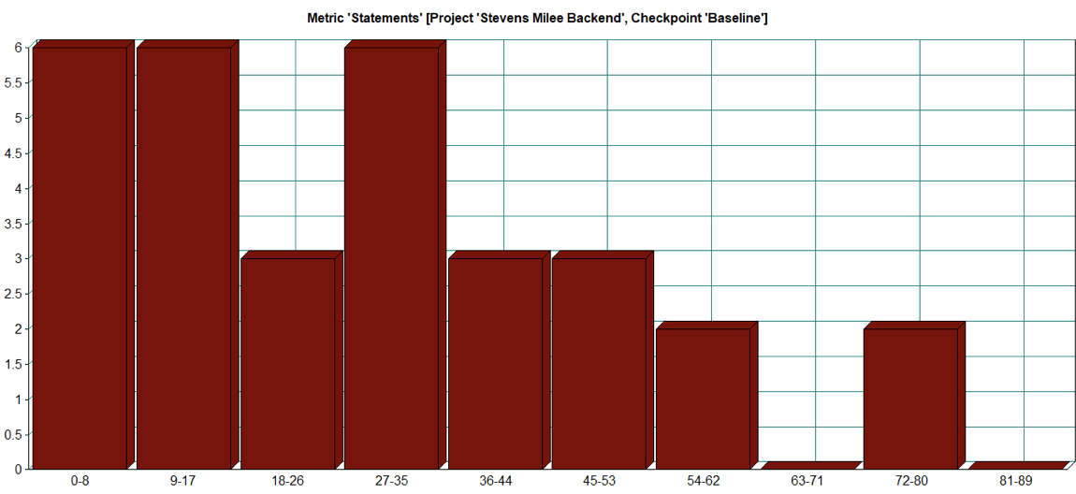
Avg. Statements/Method

Slide 17
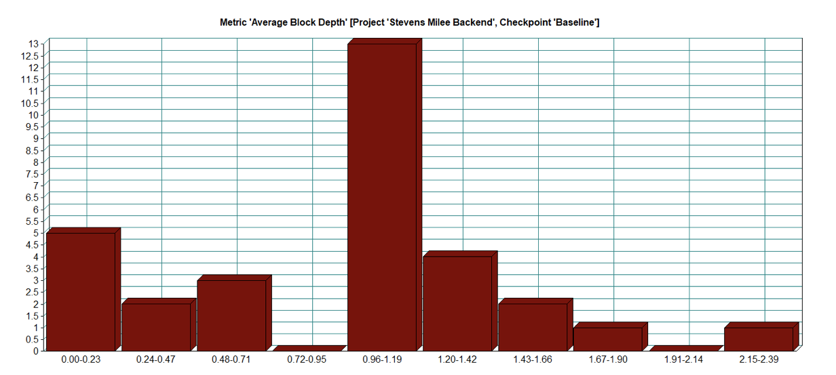
Avg. Block Depth

Slide 18
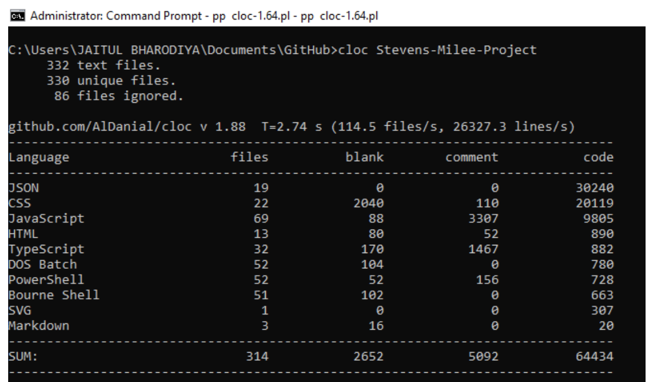
Total LOC: Frontend

Slide 19
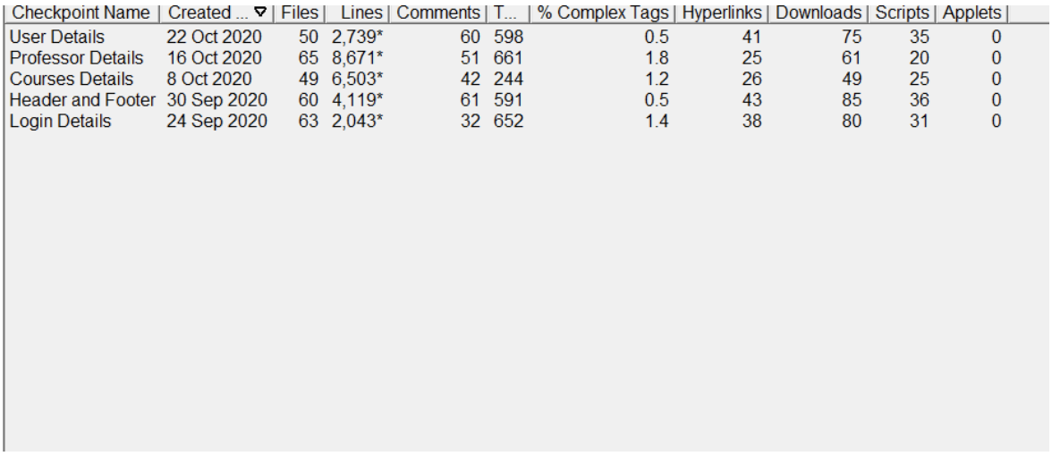
Frontend Checkpoint Metrics

Slide 20
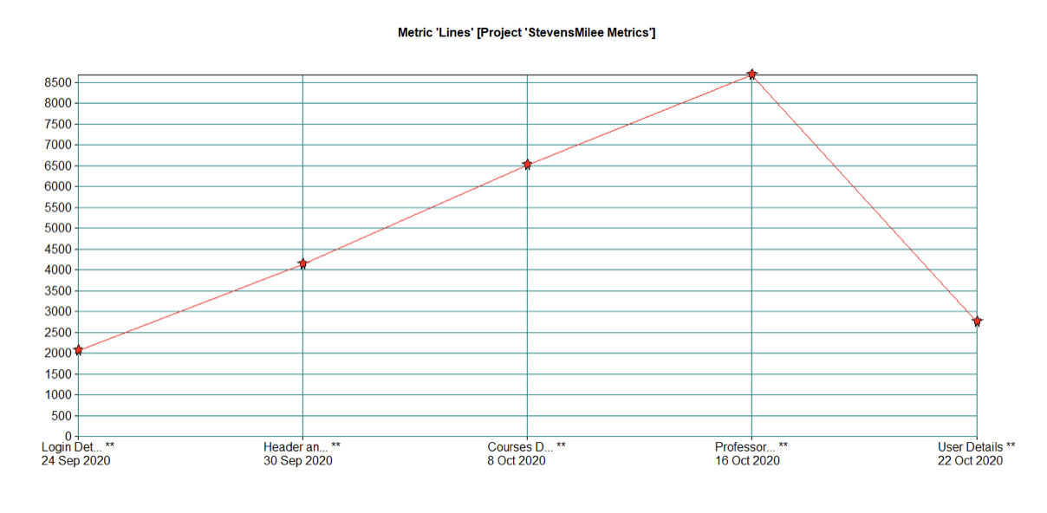
Linear Graph LOC

Slide 21
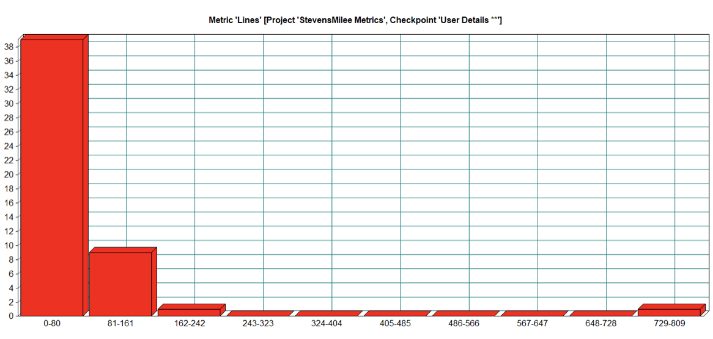
LOC/Mod

Slide 22


Github Repository
https://github.com/jaitul25/Stevens-Milee-Project
Contributors: Shivani Taneja, Jaitul Bharodiya, Rucha

Slide 23
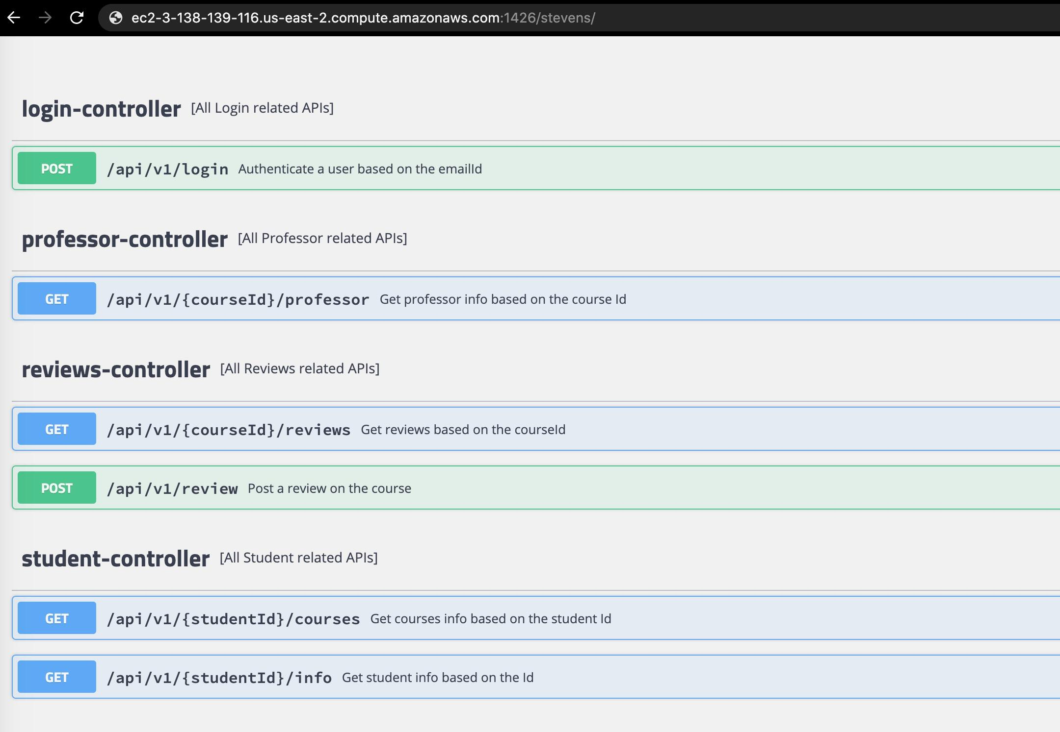
REST API Endpoints & Documentation
Link to REST API Endpoints Documentation:
http://ec2-3-138-139-116.us-east-2.compute.amazonaws.com:1426/stevens/swagger-ui.html

Slide 24

Time for the demo!

Slide 25
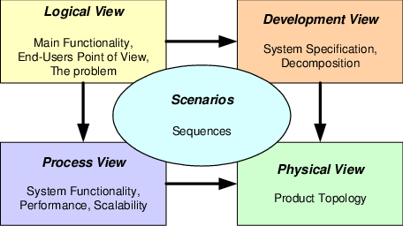
4 + 1 Architecture

Slide 26
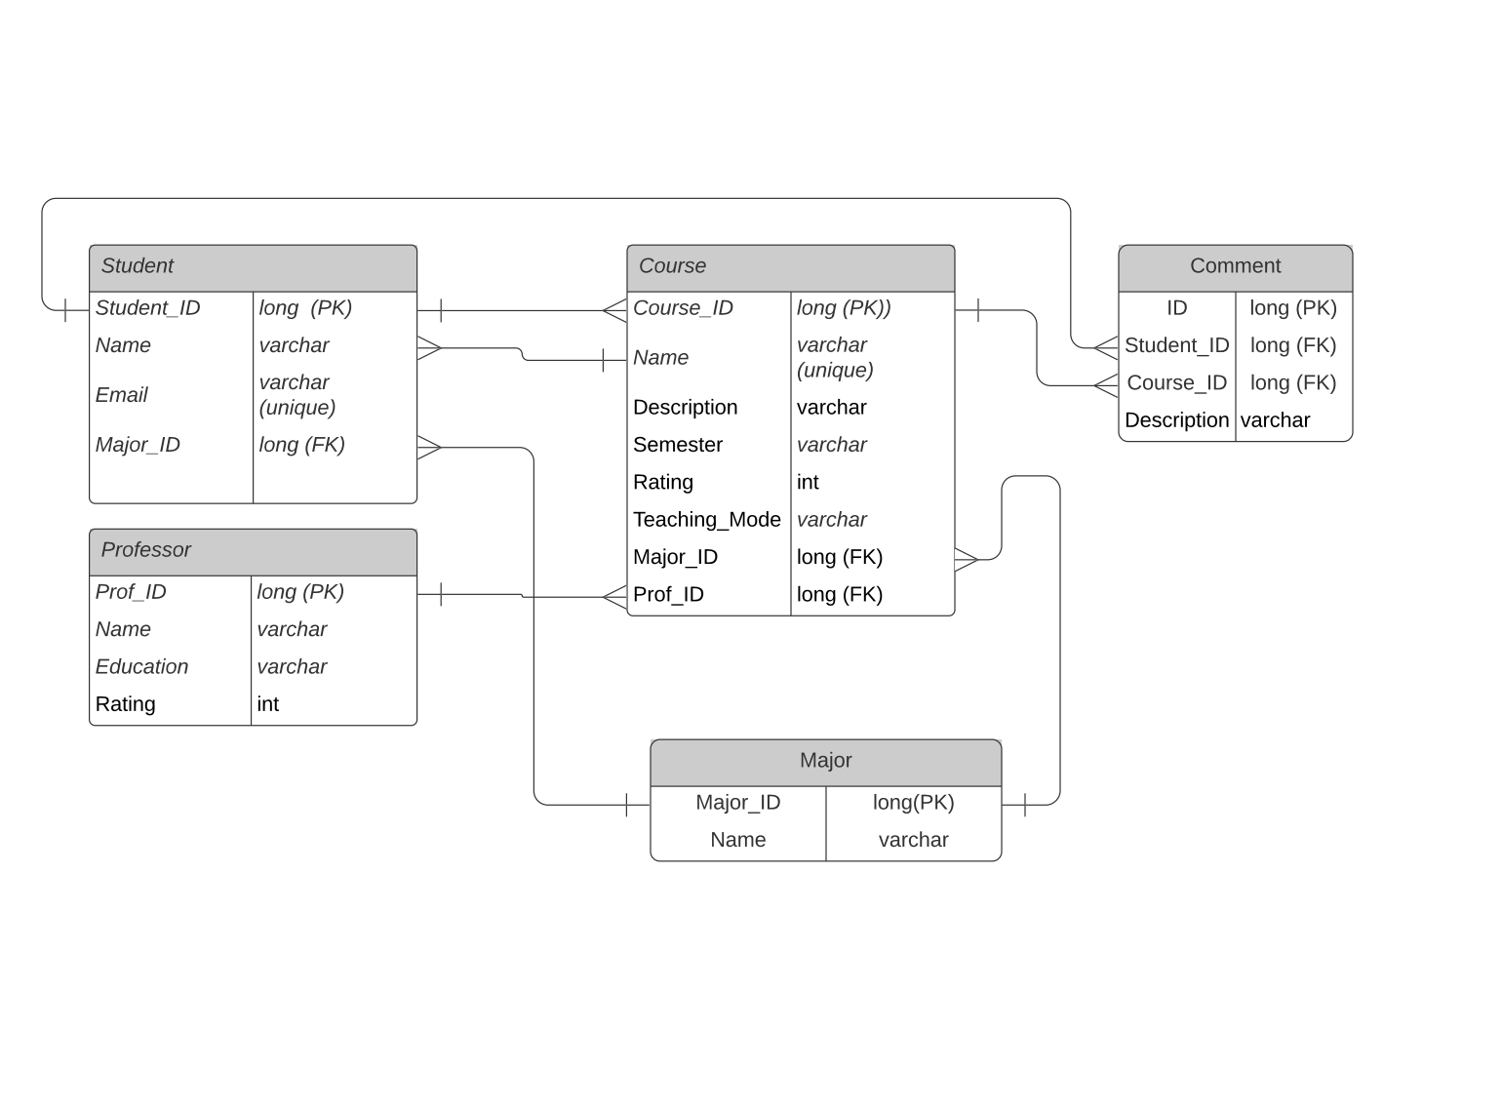
Logical View
Database Diagram

Slide 27
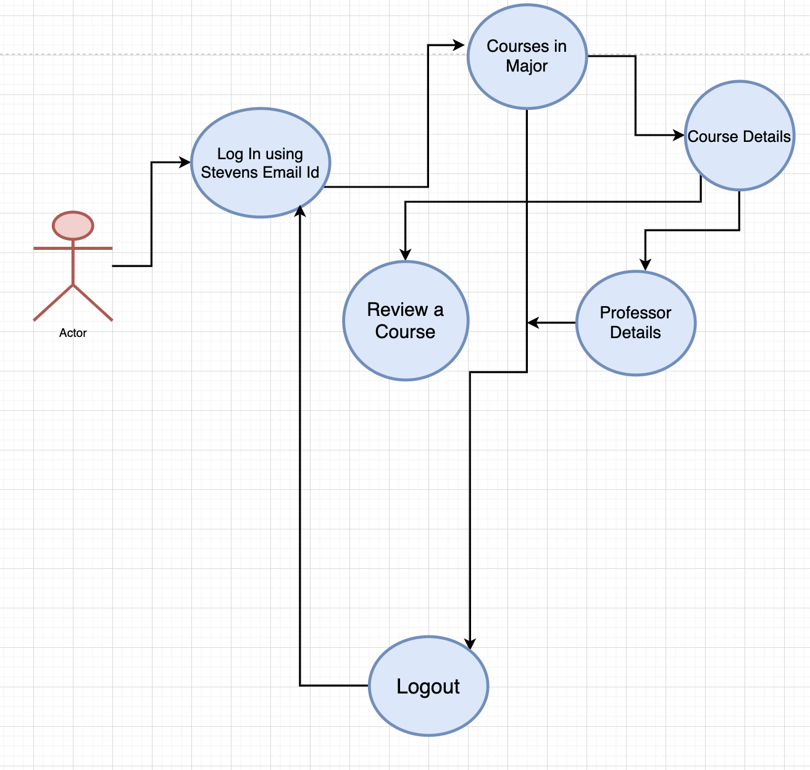
User Scenario

Slide 28
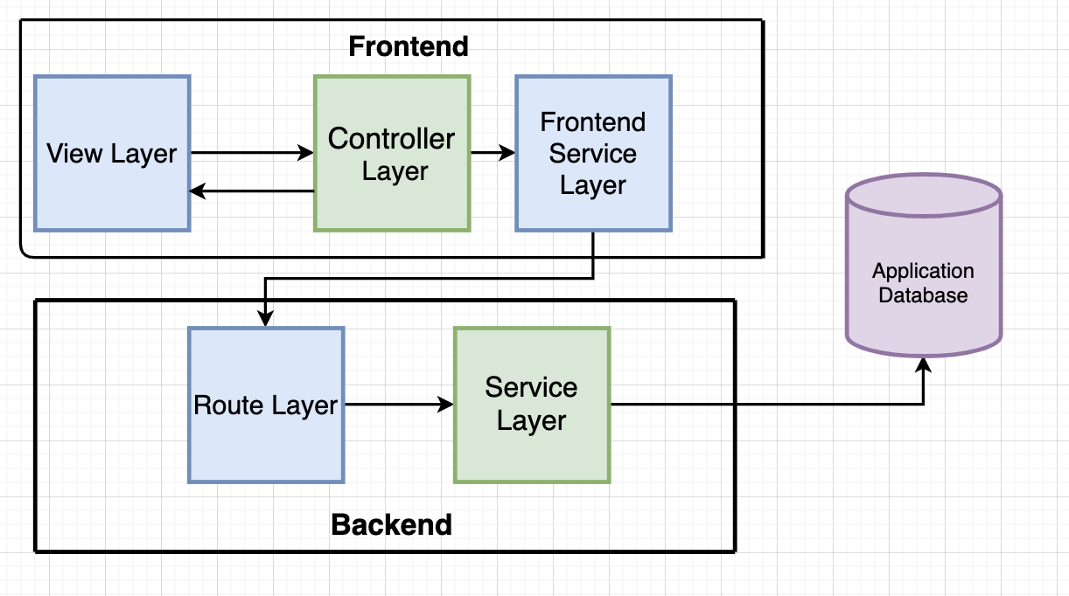
Physical View

Slide 29
Use Case View
(Login Flow Diagram)

Slide 30
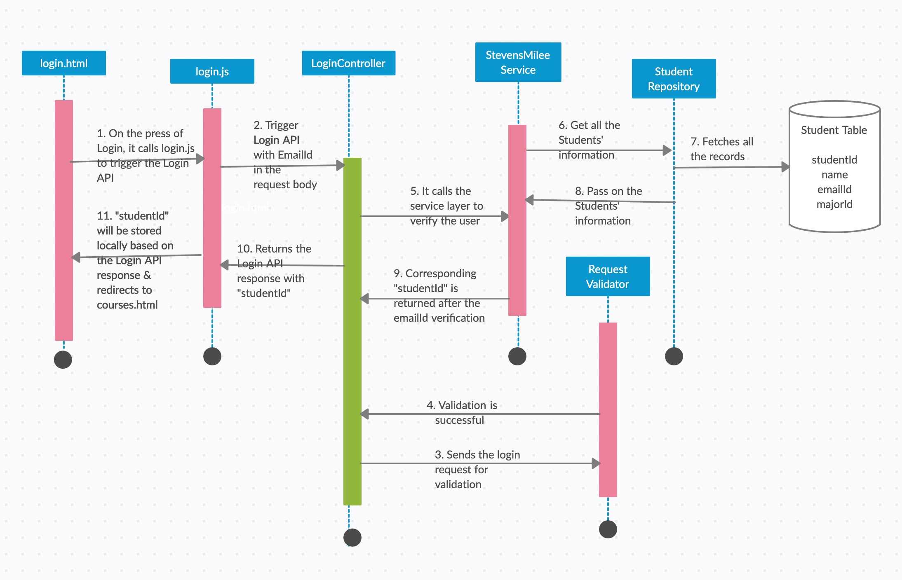

Slide 31
Use Case View
(Courses Flow Diagram)

Slide 32
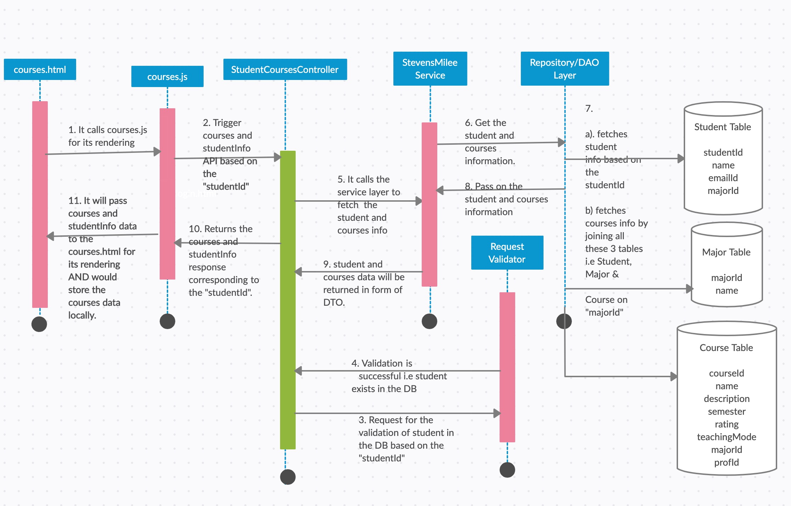

Slide 33
Use Case View
(Course Details)

Slide 34
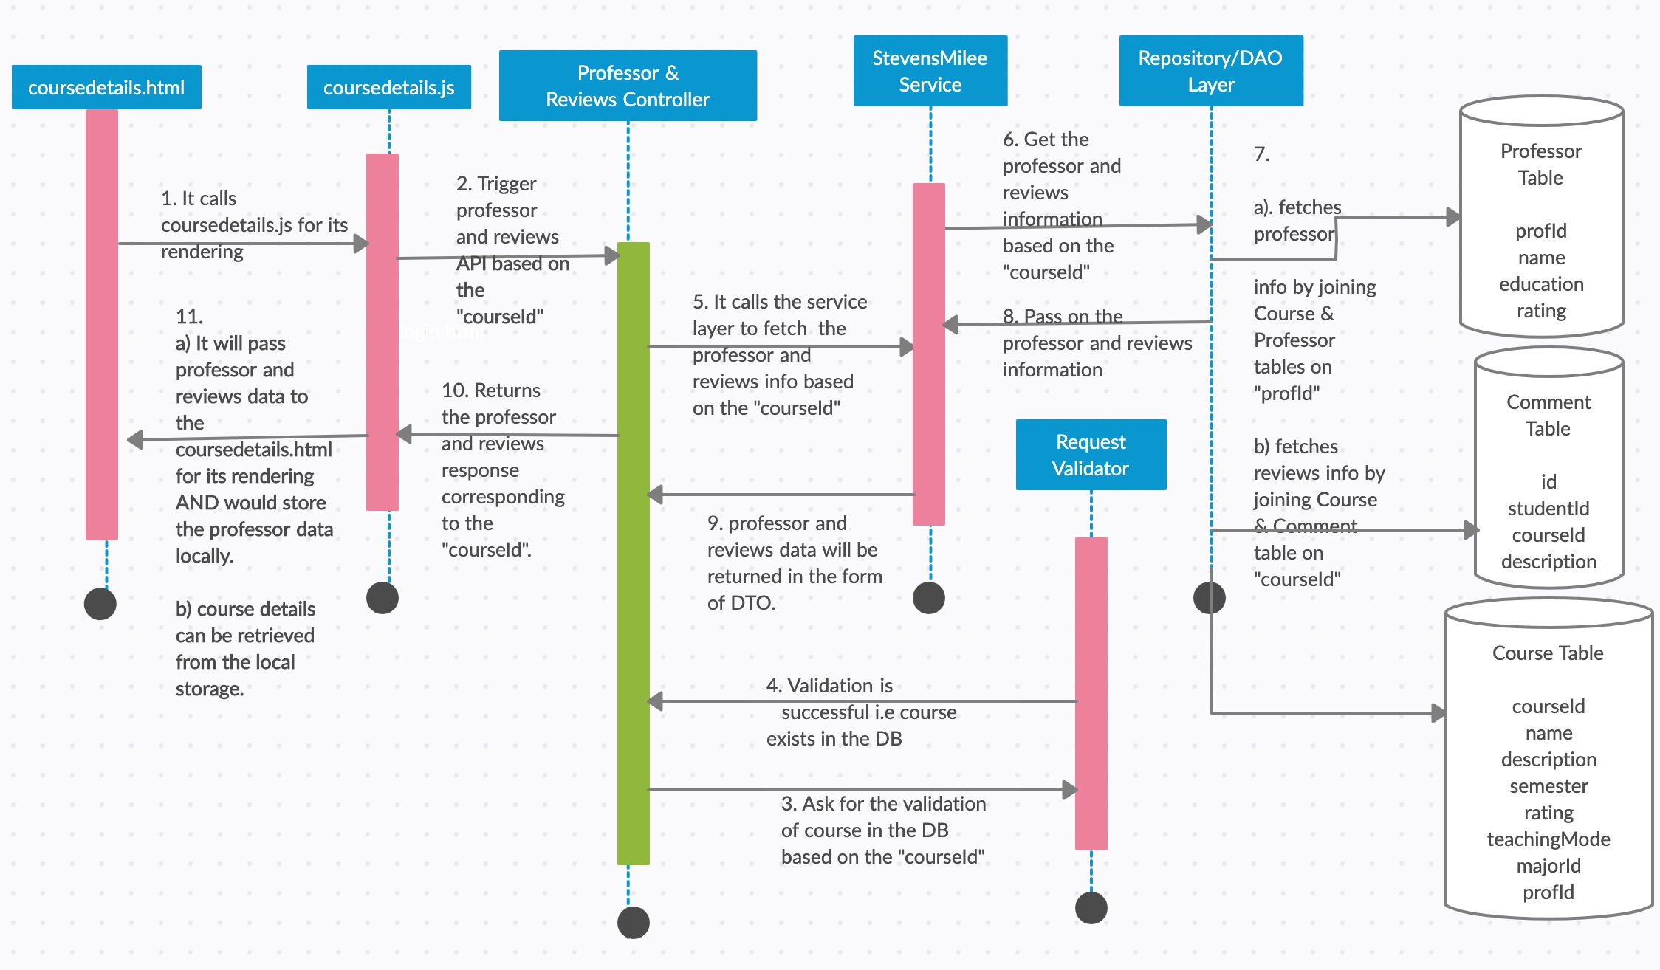

Slide 35
Security
Since our database is hosted on Amazon RDS, its firewall prevents any database access except through the rules specified by an associated security group
Used security groups to control what IP addresses or Amazon EC2 instances can connect to database on a DB instance
Used Amazon RDS encryption to secure your DB instances and snapshots at rest

Slide 36
Testing
Used Selenium WebDriver to test the web application
Created test cases in JUnit to test the backend code written in Java
Used Postman to test the APIs
Did Usability Testing using VoiceOver in Mac and also tested color contrast ratio and minimum font ratio using Webaim.org

Slide 37

Usability Testing
Accessibility testing is a Software Testing performed to ensure that the application being tested is usable by the people with disabilities like:
Hearing
Color Blindness
Old Age
Other disadvantaged groups
Tools used: VoiceOver tool MacOS

Slide 38
Development/Build Instructions
Spring Tool Suite: Backend Project installation and setup
Visual Studio: Frontend Project installation and setup
Github: Git Project and general build instructions
Merge Conflict Resolution: How to install merge tool to work on Github
CSS Style Sheet Notes

Slide 39
The Course
What was most valuable?
Architecture Review, Learnt how to work in teams, Understood how project lifecycle works, learnt new tools and technologies.
What was least valuable?
Due to time constraints, missed out feature implementation as planned at beginning.
What would you keep?
Preparing for Code Reviews helped gain more insight to the code structure.
What would you change?
According to team size, more features can be implemented if there was more time.

Slide 40
What will be same ?
We’ll use the same backend framework i.e. Spring 5 because:
MVC approach can be used while developing the APIs
It’s a popular framework and lots of enhancements have been done to provide first class REST support
It provides classes to consume REST resources
Controller handles HTTP support

Slide 41
What could have been done differently?
In terms of Tools
In terms of process
In terms of discipline
Instead of AngularJS, we could have used React
Could have improved on the design part, like graphic, photos and logos
We followed Agile Process. It was perfect choice.
Sometimes, meetings were rescheduled due to some other work that team members had. Could have done better if there was more collaboration
Delayed response on the Telegram group (used for team collaboration) lead to dependency creation on other team member and as a result delay in meeting the expected timeline

Slide 42
Next Steps in the Project
Improve the Scalability
Implement message functionality so that students can interact with each other
Improve the UI design
Implement real-time login and signup functionality because as of now, we have dummy users
To make it live, it can be integrated with canvas
As of now, there are only three majors. But we can add every major that is available at Stevens and the corresponding courses in that major
Use ElasticSearch for implementing the search functionality

Slide 43

Any Questions ?

Slide 44

Thank You

